Slide 1

Machine Learning for Survival Analysis – A Survey
Panu Looareesuwan
Notes:
Good afternoon everyone, welcome back to CEB room. I hope everyone are doing well!
Today I would like to present the paper title machine learning for survival analysis – a survey.
This paper give a very nice background of traditional survival analysis and also the background of machine learning model for survival analysis.

Slide 2
Today Contents
What is Survival Analysis?
Basic Concept
Statistical Methods
Non-parametric
Semi-parametric
Parametric
Machine Learning Methods
Survival-tree
Random Survival Forest
Deep Survival Analysis
Notes:
Today I will talk about survival analysis and its basic first. The give you a background of traditional analysis in order to understand its foundation. And then some of the machine learning models that are quite popular.

Slide 3
What is Survival Analysis?
It is a statistical technique aims to estimate the time-to-event of one or more interested events.
1
Classification:
3 +ve, 7 –ve
Cannot predict the time of event
2
3
4
Regression:
3 samples have event, uncensored not taken into account. Loss of information
Subject
5
6
7
8
Loss to follow up / censored
9
Death / Event occur
10
1
2
4
5
6
8
9
Other events
3
7
10
11
12
Time (months)
Notes:
So what is survival analysis? The definition is it is a statistical technique that aims to estimate the time-to-event of one or more interested event.
Why do we even need this?
Let says that we have longitudinal dataset like this on the left. We have 10 subjects and we have their data for 12 months.
The red cross represent the event that we are interested in / death. So there are 3 subjects that died in this study.
Normally solve can solve this problem by either classification or regression.

Slide 4
Censoring
Left-censor
Right-censor
Interval-censor
?
+ve for disease
Virus exposure
-ve for disease
?
+ve for disease
Virus exposure

Slide 5
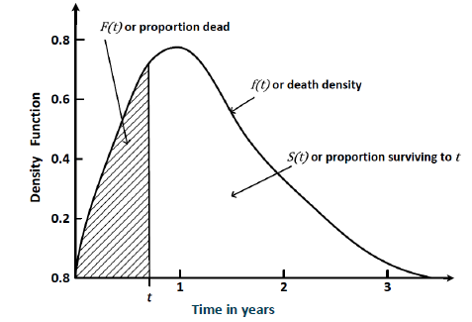
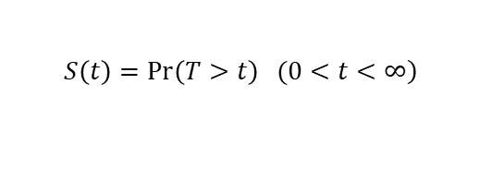
Basic Concept of Survival Analysis
Survival Function:
Probability that the instance can survive longer than certain time t.
Hazard Function
Instantaneous death rate at which the interested event occur, given that the subject survive to time t.
$$\left.S\left(t\right)=\operatorname{Pr}\left(T>t\right) (0<t<∞\right)$$
$$h\left(t\right)=\lim_{∆→0}{\frac{\operatorname{Pr}\left(t≤T<t+∆t \right| T≥t) }{∆t}}$$

Slide 6
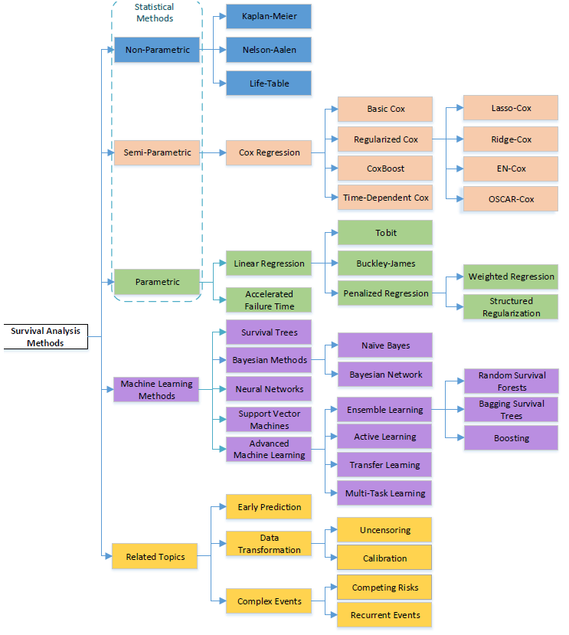
Taxonomy of Survival Analysis Methods

Slide 7

Statistical Method - Kaplan Meier Analysis
Kaplan-Meier (KM) is a non-parametric approach to find survival function.
$$\hat{S}\left(t\right)= \prod_{j=1}^{k}{\left(\frac{n_{j}−d_{j}}{n_{j}}\right)}$$
where:
dj – number of event at time j
nj – number of instances at risk at time j
time | population | n | d | c | survival at time t | S(t)
1 | 38 | 32 | 6 | 0 | 0.84 | 0.84
2 | 32 | 27 | 5 | 0 | 0.84 | 0.71
3 | 27 | 23 | 3 | 1 | 0.85 | 0.61
4 | 23 | 19 | 3 | 1 | 0.83 | 0.50
6 | 19 | 16 | 2 | 1 | 0.84 | 0.42
9 | 16 | 9 | 3 | 4 | 0.56 | 0.24
10 | 9 | 8 | 1 | 0 | 0.89 | 0.21
13 | 8 | 6 | 1 | 1 | 0.75 | 0.16
16 | 6 | 5 | 1 | 0 | 0.83 | 0.13

Slide 8
Advantages and Disadvantages
Methods | Advantages | Disadvantages
Non-Parametric | More efficient when no suitable theoretical distributions known. | Difficult to interpret; yields inaccurate estimates.
Semi-Parametric | The knowledge of the underlying distribution of survival times is not required. | The distribution of the outcome is unknown; Not easy to interpret.
Parametric | Easy to interpret, more efficient and accurate when the survival times follow a particular distribution. | When the distribution assumption is violated, it may be inconsistent and can give sub-optimal results.

Slide 9
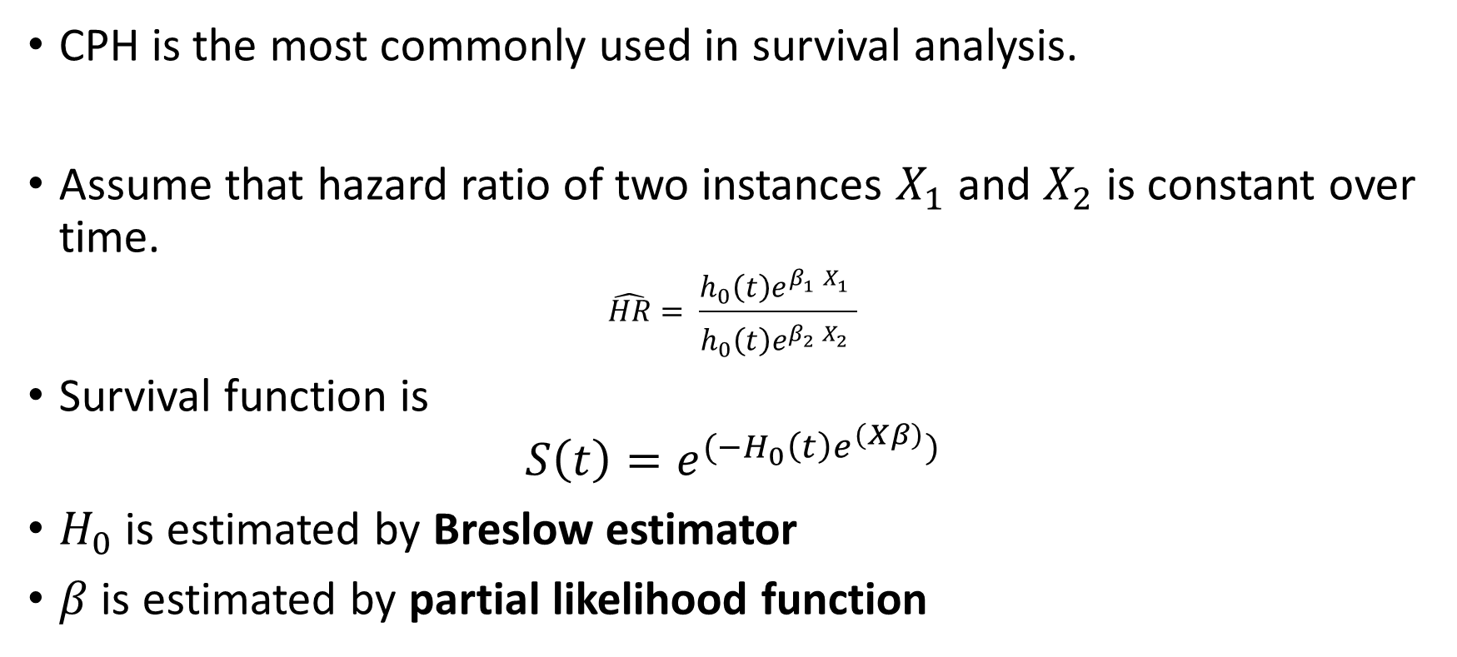

Statistical Method – Cox Proportional Hazard (CPH)
CPH is the most commonly used in survival analysis.
Assume that hazard ratio of two instances $X_{1}$ and $X_{2}$ is constant over time.
$$\hat{HR}= \frac{h_{0}\left(t\right)e^{β_{1}^{}X_{1}^{}}}{h_{0}\left(t\right)e^{β_{2}^{}X_{2}^{}}}$$
Survival function is
$$S\left(t\right)=e^{(−H_{0}\left(t\right)e^{\left(Xβ\right)})}$$
$H_{0}$ is estimated by Breslow estimator
$β$ is estimated by partial likelihood function
$$h\left(t,X\right)= h_{0}\left(t\right)e^{\sum_{i=1}^{p}{β_{i}X_{i}}}$$
Notes:
HR gives the value that indicate who has high risk of death than the other.
H0 (cumulative hazard function) can be compute using Breslow estimator.
The beta in cox model is optimized by using partial likelihood function.

Slide 10
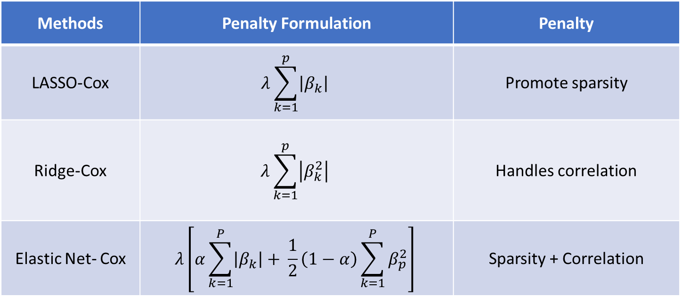

Regularized Cox Model
Aim to optimized $β$ in the cox model
Methods | Penalty Formulation | Penalty
LASSO-Cox | $$λ\sum_{k=1}^{p}{\left|β_{k}\right|}$$ | Promote sparsity
Ridge-Cox | $$λ\sum_{k=1}^{p}{\left|β_{k}^{2}\right|}$$ | Handles correlation
Elastic Net- Cox | $$λ\left[α\sum_{k=1}^{P}{\left|β_{k}\right|+ \frac{1}{2}\left(1−α\right)\sum_{k=1}^{P}{β_{p}^{2}}}\right]$$ | Sparsity + Correlation
Notes:
LASSO-Cox does feature selection as well to reduce overfitting of the cox model

Slide 11
Advantages and Disadvantages
Methods | Advantages | Disadvantages
Non-Parametric | More efficient when no suitable theoretical distributions known. | Difficult to interpret; yields inaccurate estimates.
Semi-Parametric | The knowledge of the underlying distribution of survival times is not required. | The distribution of the outcome is unknown; Not easy to interpret.
Parametric | Easy to interpret, more efficient and accurate when the survival times follow a particular distribution. | When the distribution assumption is violated, it may be inconsistent and can give sub-optimal results.

Slide 12
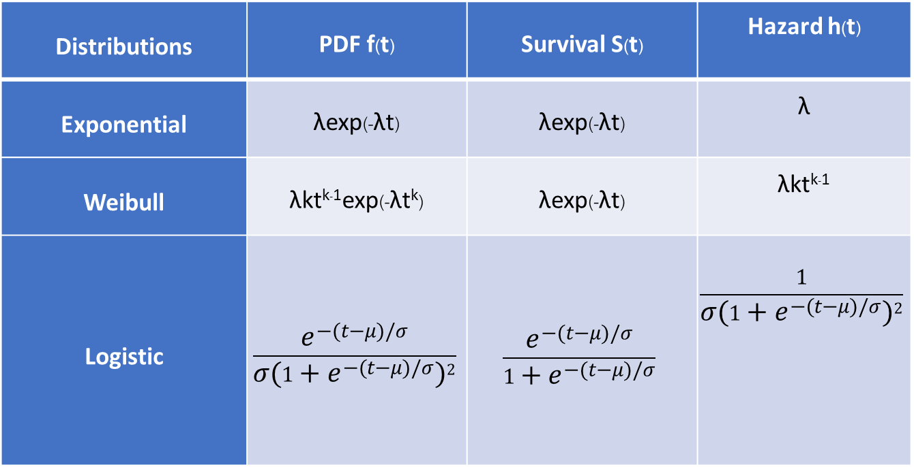
Statistical Method – Parametric Model
Distributions | PDF f(t) | Survival S(t) | Hazard h(t)
Exponential | λexp(-λt) | λexp(-λt) | λ
Weibull | λkt^{k-1}exp(-λt^{k}) | λexp(-λt) | λkt^{k-1}
Logistic | $$\frac{e^{−(t−μ)/σ}}{{σ(1+e^{−(t−μ)/σ})}^{2}}$$ | $$\frac{e^{−(t−μ)/σ}}{1+e^{−(t−μ)/σ}}$$ | $$\frac{1}{{σ(1+e^{−(t−μ)/σ})}^{2}}$$

Slide 13
Advantages and Disadvantages
Methods | Advantages | Disadvantages
Non-Parametric | More efficient when no suitable theoretical distributions known. | Difficult to interpret; yields inaccurate estimates.
Semi-Parametric | The knowledge of the underlying distribution of survival times is not required. | The distribution of the outcome is unknown; Not easy to interpret.
Parametric | Easy to interpret, more efficient and accurate when the survival times follow a particular distribution. | When the distribution assumption is violated, it may be inconsistent and can give sub-optimal results.

Slide 14
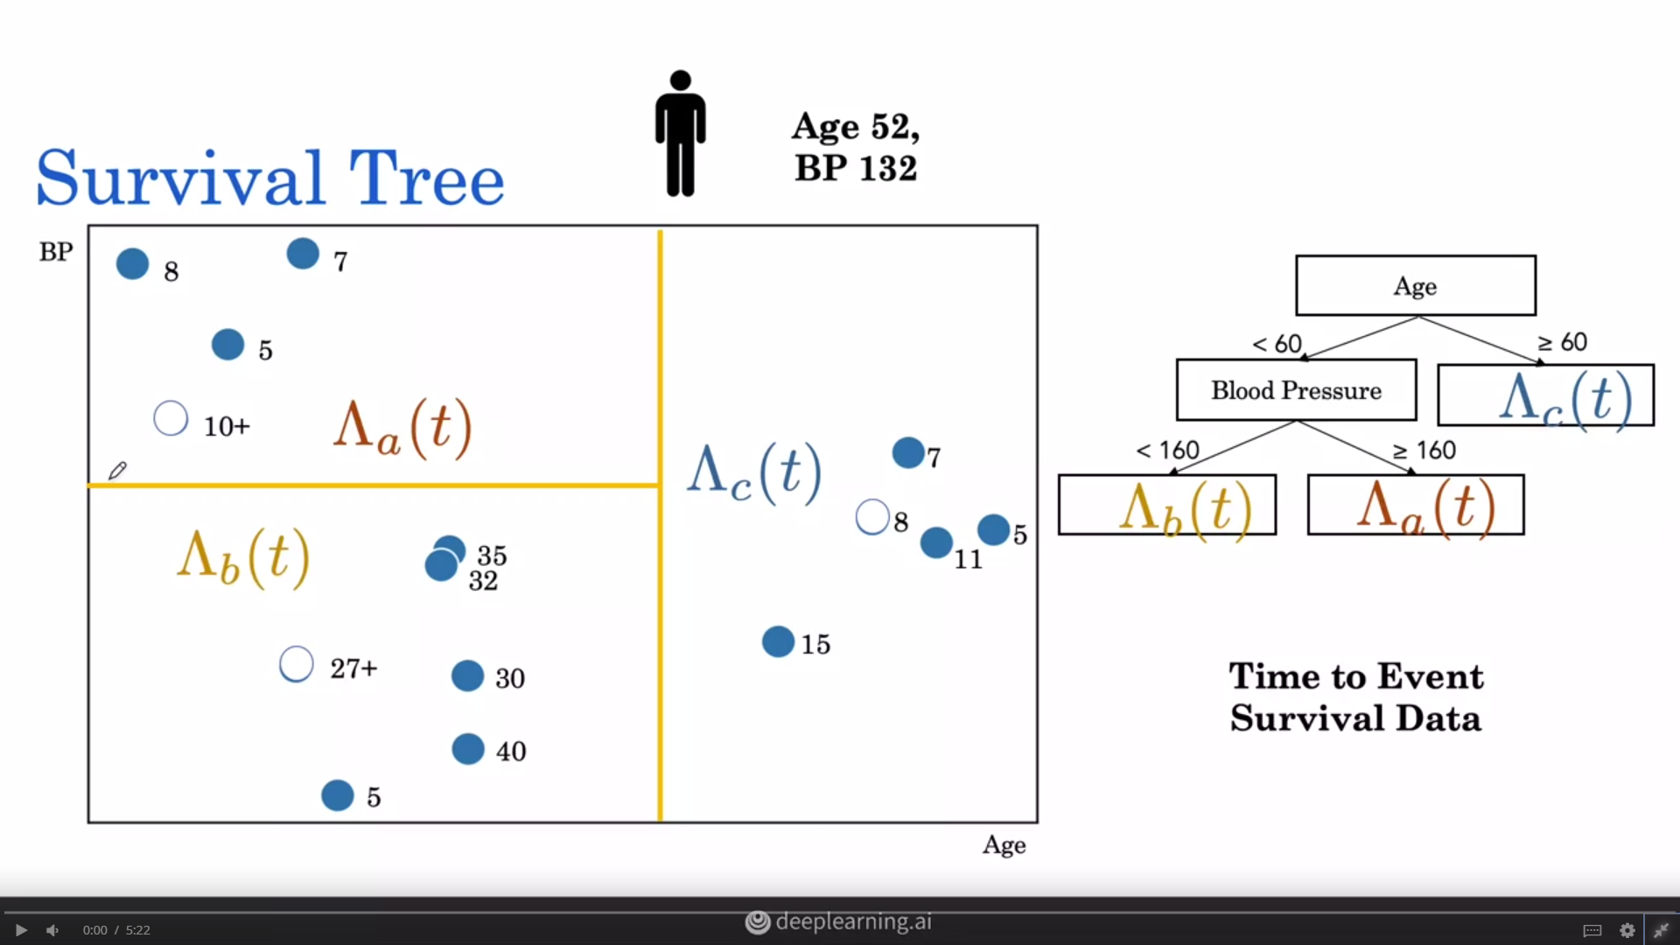
Machine Learning Methods – Survival Tree
The difference between decision tree and survival tree is splitting criterion. Objective function:-
Maximizing between-node heterogeneity
Minimizing within-node homogeneity
I | Time
1 | 40
2 | 35
3 | 32
4 | 30
5 | 27+
6 | 5
https://www.coursera.org/learn/ai-for-medical-prognosis/lecture/luE0A/nelson-aalen-estimator
Notes:
Nelson-aalen estimator to estimate cumulative hazard function
Maximize survival differences. The logrank test is most commonly used dissimilarity measure that estimates the survival difference between two groups (can also be likelihood ratio statistic, Wilcoxon–Gehan statistics and Kolmogorov–Smirnov statistic.

Slide 15
Advantages and Disadvantages of Survival Tree
Advantages
Fast and easy to implement
Interpretable (white box)
Doesn’t require feature normalization
Disadvantages
Difficult to choose final tree
Tend to overfit

Slide 16
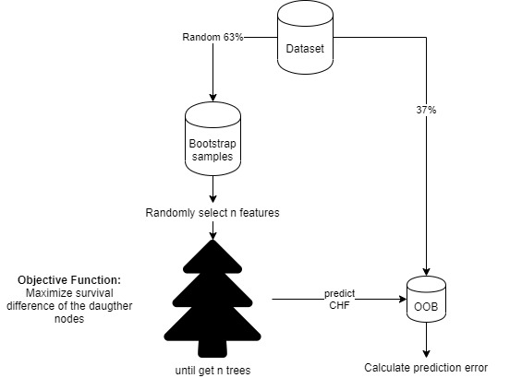
Machine Learning Methods – Random Survival Forest (RSF)
Basically, many survival trees helping to decide the output.
Notes:
The CHF estimate for h is the Nelson–Aalen estimator

Slide 17
Advantages and Disadvantages of RSF
Advantages
More generalize then survival tree
Explainable
Disadvantages
Computationally expensive
Result biased toward the features that has many split points
Reference: A comparison of the conditional inference survival forest model to random survival forests based on a simulation study as well as on two applications with time-to-event data

Slide 18
Machine Learning Methods – Neural Networks
First applied in 1995 by Faraggi D, Simon R but failed.
Neural Network doesn’t outperform CPH until 2016
Adaptation from semi-parametric model
DeepSurv (FC Layer)
Cox-nnet (FC Layer)
Adaptation from parametric model
Nnet-survival (CNN)
RNN-SURV (LSTM)
Competing Risk
DeepHit
Survival Analysis from Medical Image
DeepConvSurv (CNN)

Slide 19
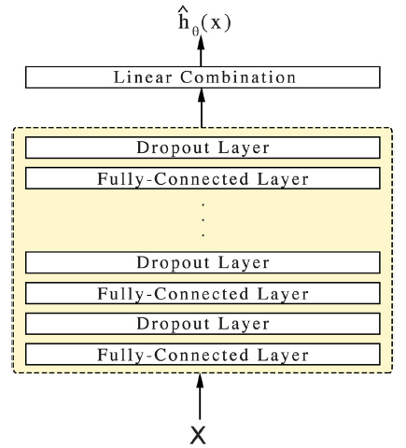
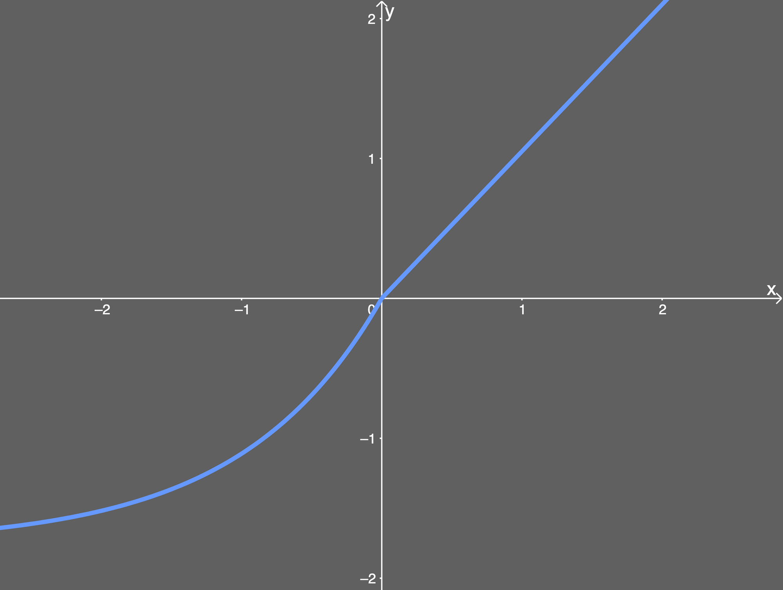
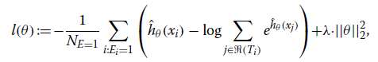
Neural Network – DeepSurv
Feed-forward neural network
Average negative partial log likelihood from CoxPH
Standardized input with
SELU activation functions
Adam optimizer
Experiment | CPH | DeepSurv | RSF
Simulated Linear | 0.78 (0.777,0.781) | 0.78 (0.776,0.780) | 0.76 (0.756,0.760)
Simulated Nonlinear | 0.49 (0.484,0.489) | 0.65 (0.650, 0.655) | 0.63 (0.624,0.629)
WHAS | 0.82 (0.813, 0.819) | 0.87 (0.863,0.870) | 0.89 (0.890,0.895)
SUPPORT | 0.58 (0.581,0.585) | 0.62 (0.617,0.621) | 0.62 (0.618,0.621)
METABRIC | 0.63 (0.627,0.636) | 0.65 (0.650,0.659) | 0.62 (0.615,0.624)
Simulated Treatment | 0.52 (0.514,0.519) | 0.58 (0.573,0.578) | 0.55 (0.548,0.553)
Rotterdam & GBSG | 0.66 (0.655, 0.662) | 0.68 (0.673,0.679) | 0.65(0.644, 0.651)
Loss function
DeepSurv: Personalized Treatment Recommender System Using A Cox Proportional Hazards Deep Neural Network https://arxiv.org/abs/1606.00931
Notes:
SELU activation function (Scaled Exponential Linear Units )
X is baseline patients data
Output as log-risk function / hazard rate
Deepsurv stills used CoxPH assumption but because of architecture of neural network, it can capture non-linear features to compute hazard function.

Slide 20
Advantages and Disadvantages of DeepSurv
Advantages
State-of-the-art performance
effective treatment recommendations based on individual’s risk
Disadvantages
Cannot explain which features contribute more to the prediction
Relie

Slide 21
Machine Learning Methods – Bayesian Network

Slide 22
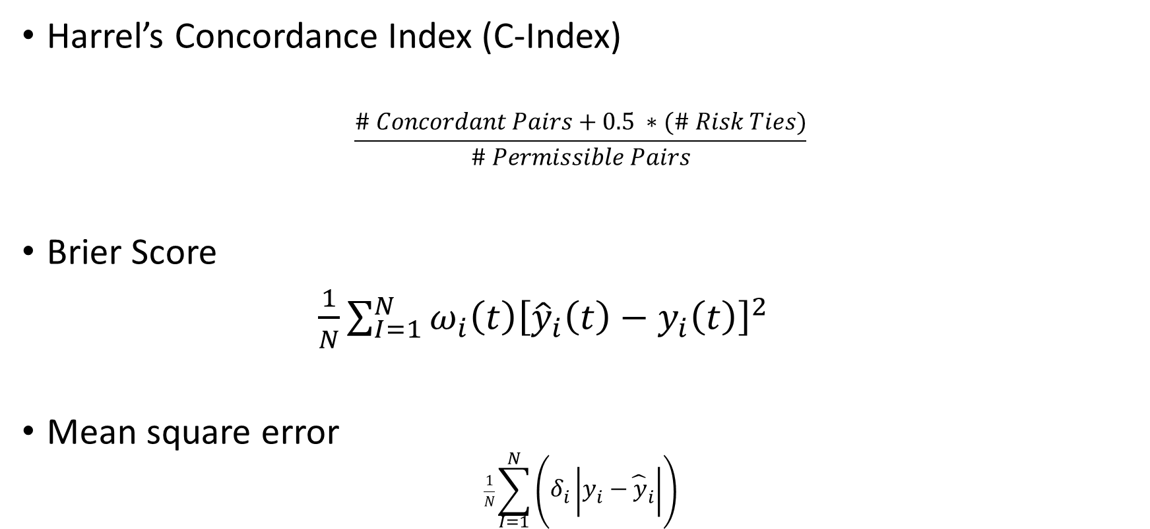
Evaluation Metrics
Harrel’s Concordance Index (C-Index)
$$\frac{\# Concordant Pairs+0.5 ∗(\# Risk Ties)}{\# Permissible Pairs}$$
Brier Score
$\frac{1}{N}\sum_{I=1}^{N}{ω_{i}\left(t\right){\left[{\hat{y}}_{i}\left(t\right)−y_{i}\left(t\right)\right]}^{2}}$
Mean square error
$$\frac{1}{N}\sum_{I=1}^{N}{\left(δ_{i}\left|y_{i}−{\hat{y}}_{i}\right|\right)}$$

Slide 23
Thank you

Slide 24
References
https://www.ncbi.nlm.nih.gov/pmc/articles/PMC5909924/
https://arxiv.org/abs/1805.00917
http://medianetlab.ee.ucla.edu/papers/RNN_SURV.pdf
http://medianetlab.ee.ucla.edu/papers/AAAI_2018_DeepHit.pdf
https://ieeexplore.ieee.org/document/7822579

